Slide 1
Smart Traffic & IIoT
Conceptual Application
Nicolas Giot

Slide 2
Smart Traffic Management with Generative AI
Using edge computing and generative AI to
create a responsive, efficient traffic system
We want to ensure that it:
Leverages traffic cameras, GPS data, and speed sensors
Uses AI to simulate future traffic conditions and suggest reroutes
Operates on edge devices to minimize latency and protect user privacy
Reduces congestion, improves safety, and lowers emissions
Saves your time!
Nicolas Giot

Slide 3

Objectives & Goals
Design conceptual AI edge system that reroutes vehicles in real time
Create an autonomous agent to analyze live video and GPS data
Dynamically guide traffic through alternate routes
Simulate multiple traffic outcomes before choosing an action
Minimize infrastructure reliance on centralized cloud processing
Ability to execute
Targeted Outcomes
15–30% reduction in commute time in congested zones
Improved emergency response times via dynamic path clearing
Reduced idle-related emissions at intersections
Nicolas Giot
Month Year

Slide 4
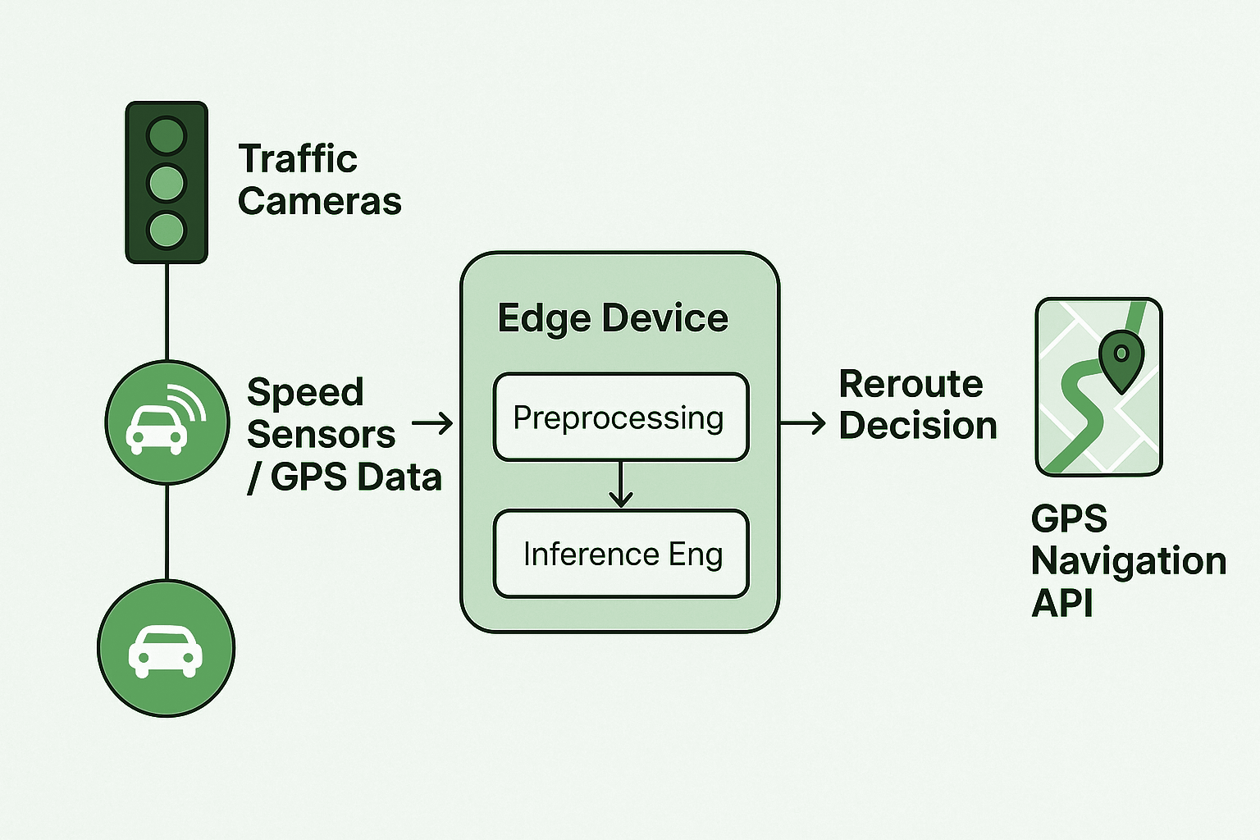
System Architecture Overview
Hardware & Protocols
Devices: Jetson Nano, Coral, Raspberry Pi (NPU capable)
Protocols: MQTT (telemetry), RTSP (video), HTTPS (API integration)
Security: TLS encryption, local license plate/face blurring
Outline of sensor data flow and AI-driven decision-making pipeline

Slide 5
AI Models and Decision Framework
Generative and reinforcement-based models simulate future traffic and decide optimal actions
Decision-Making Logic
AI Models Used
Tooling
GANs: Simulate alternate traffic flows based on possible incidents
Diffusion Models: Predict and generate smooth traffic distribution patterns
Synthetic Data: Fill gaps in training for rare conditions (accidents, weather events)
Reinforcement Learning: Trained in traffic simulators (e.g., SUMO) for policy learning
Rule-Based Constraints: For construction, safety, or emergency reroutes
Fallback Models: LSTM / CNNs for traffic prediction if generative AI fails
TensorFlow Lite
Edge Impulse
OpenCV
Nicolas Giot

Slide 6

Security & Ethics
Ensuring user privacy, safety, and fair decision-making in AI-based traffic rerouting
Data Security
- TLS 1.3 and AES-256 encryption between devices
- JWT/OAuth2 authentication for all API endpoints
- Encrypted model storage on edge devices
Privacy Protections
- Local blurring of license plates and faces
- Opt-in GPS telemetry only
- No personally identifiable data stored
Ethical Safeguards
- Simulation bias checks to avoid disadvantaging neighborhoods
- Public transparency on data collection and rerouting logic
- Explainability modules for auditability and fairness
Nicolas Giot

Slide 7

Summarizing benefits, challenges, and next steps in conceptual development
Takeaways and Direction
Core Strengths
Challenges & Trade-offs
Future Enhancements
Local decision-making minimizes cloud load and response time
Scalable to multiple intersections or highway segments
Privacy-first approach with secure edge processing
Balancing model complexity with edge compute limits
GPS API integration may be limited by third-party providers
Traffic behavior is influenced by human unpredictability
Federated learning for cross-city coordination
Integration with public transit schedules and weather systems
Community dashboard for transparency and urban planning input
Nicolas Giot

Slide 8
Thank you

